Slide 1


Slide 2
Hospital Management System(HMS) was introduced to solve the complications coming from managing all the paper works of every patient associated with the various departments of hospitalization with confidentiality. HMS provides the ability to manage all the paperwork in one place, reducing the work of staff in arranging and analysing the paperwork of the patients.
What is Hospital Management System ?

Slide 3
What does Hospital Management System do?
Maintain the Medical Records of the Patients.
Maintain the Contact Detail of the Patients.
Keep Track of the appointment Date.
Tracking the Bill Payment.

Slide 4
Advantages of Hospital Management System.
The advantages of HMS can be pinpointed to the following:
Time-saving Technology.
Improved Efficiency.
Reduces scope for Error.
Data security and correct data retrieval made possible.
Cost effective and easily manageable.
Easy access to patient data with correct patient history
Improved patient care made possible
Easy monitoring of supplies in inventory
Reduces the work of documentation
Better Audit controls and policy compliance.

Slide 5
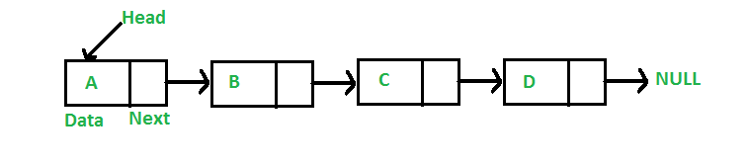
A linked list is a linear data structure, in which the elements are not stored at contiguous memory locations. The elements in a linked list are linked using pointers as shown in the below image:
Data Structure Used-
Circular Doubly Linked List

Slide 6
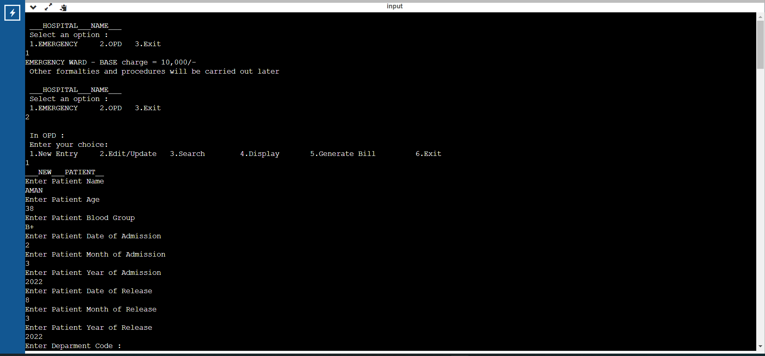
Outputs

Slide 7
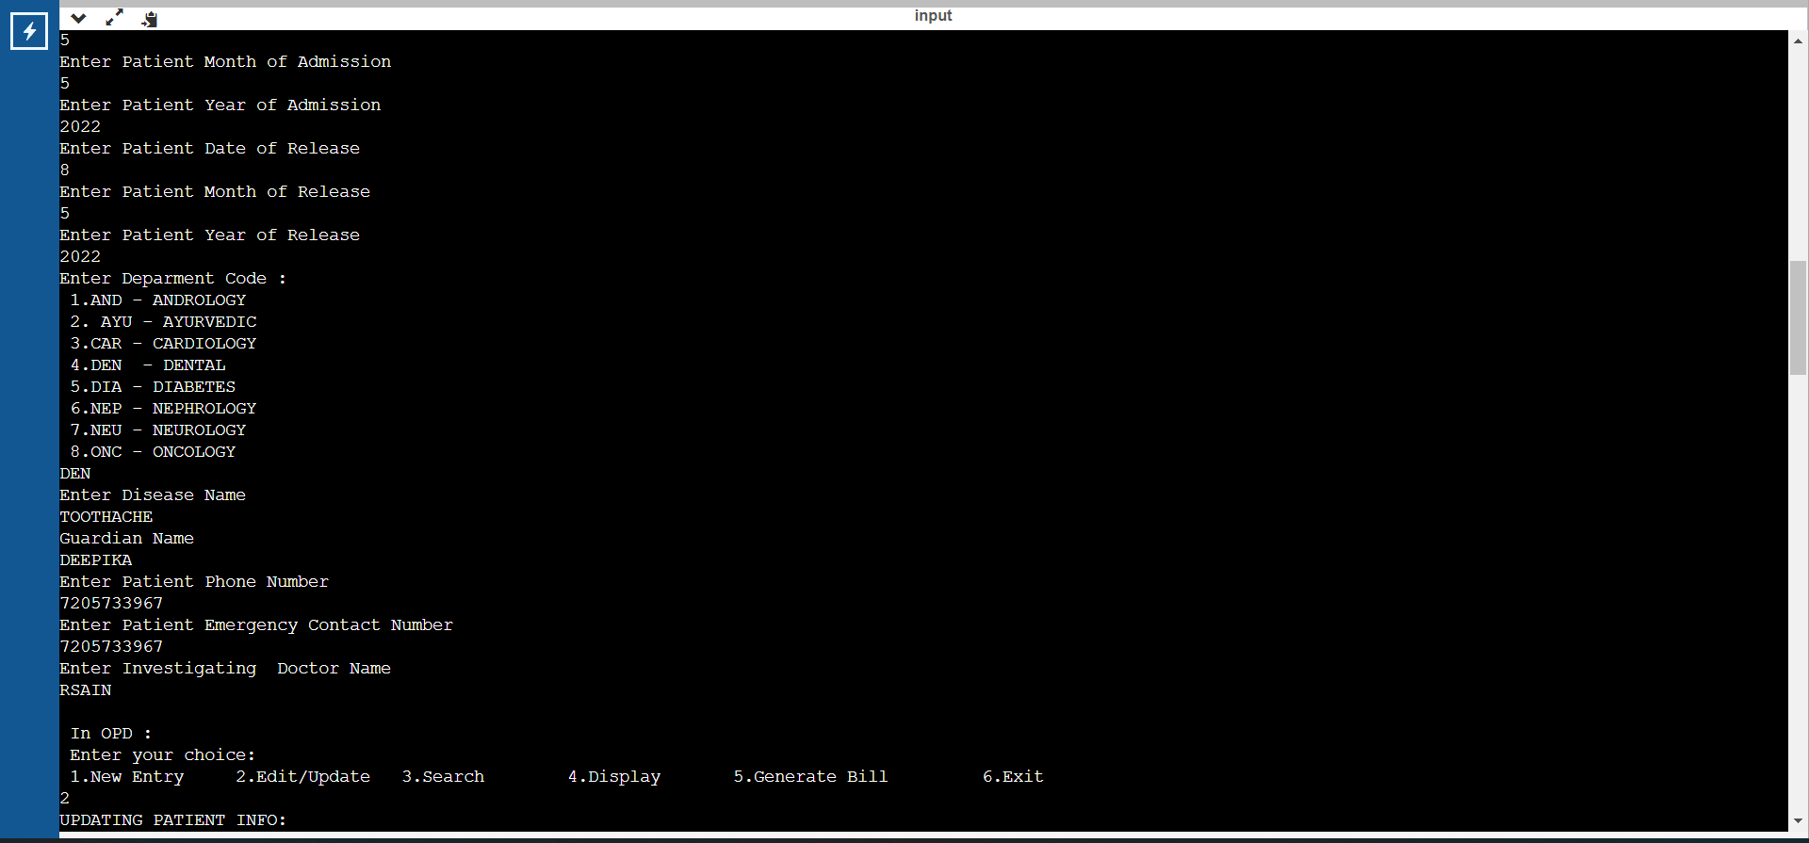
Outputs

Slide 8
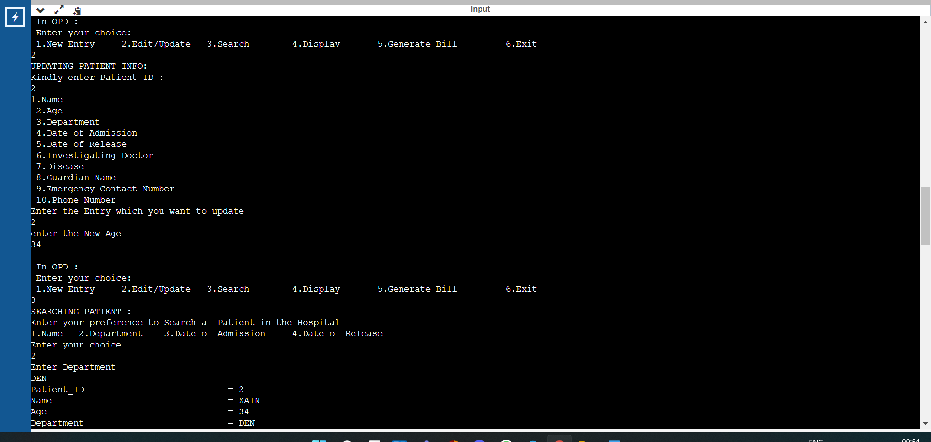
Outputs

Slide 9
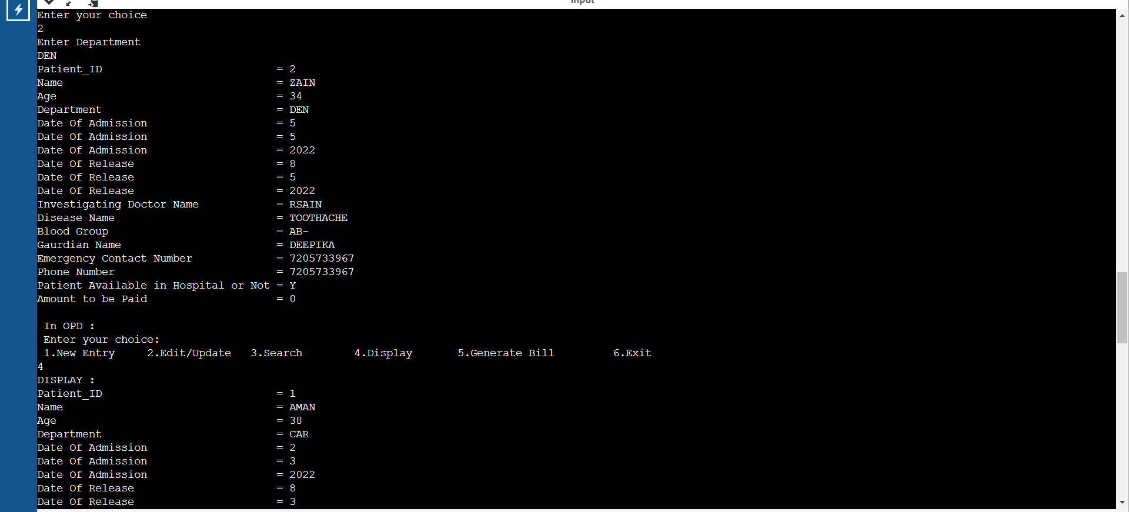
Outputs

Slide 10
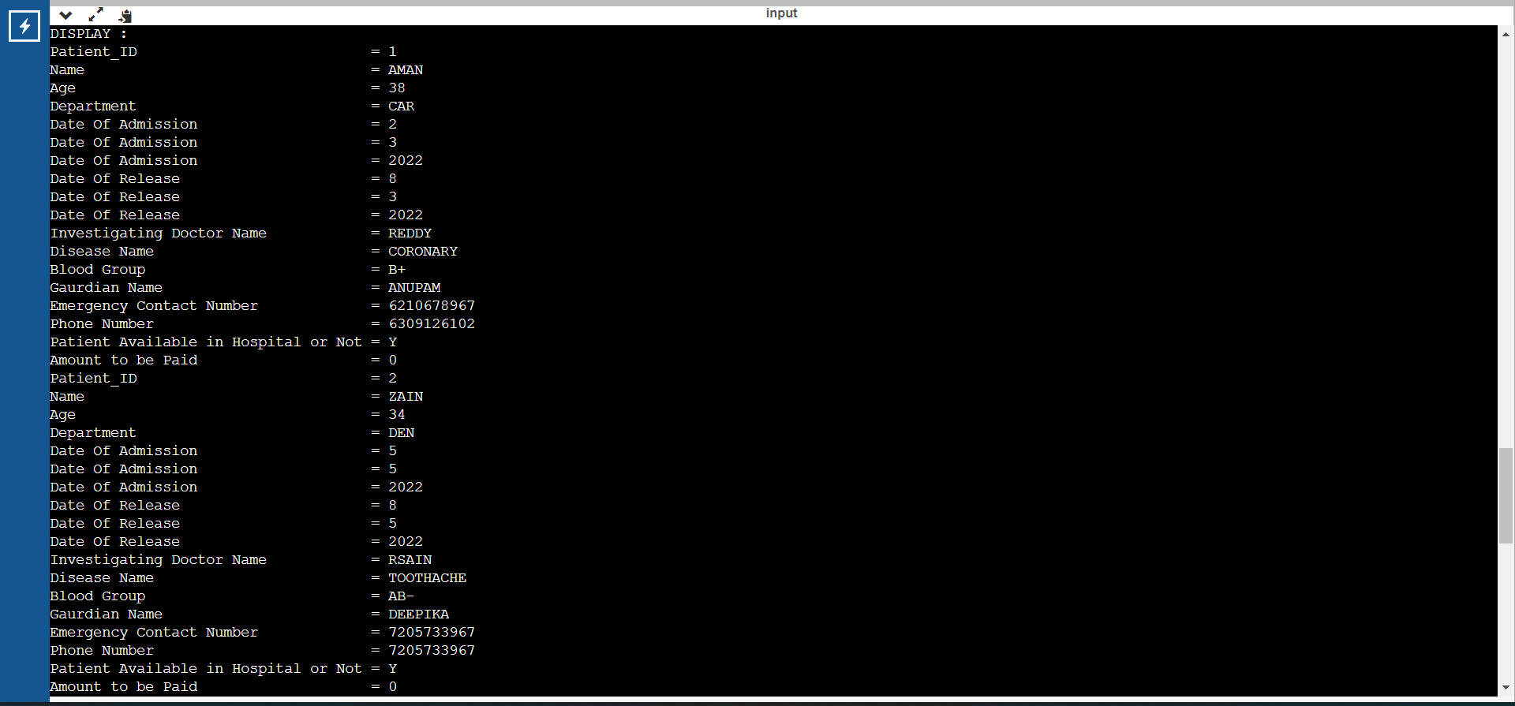
Outputs

Slide 11
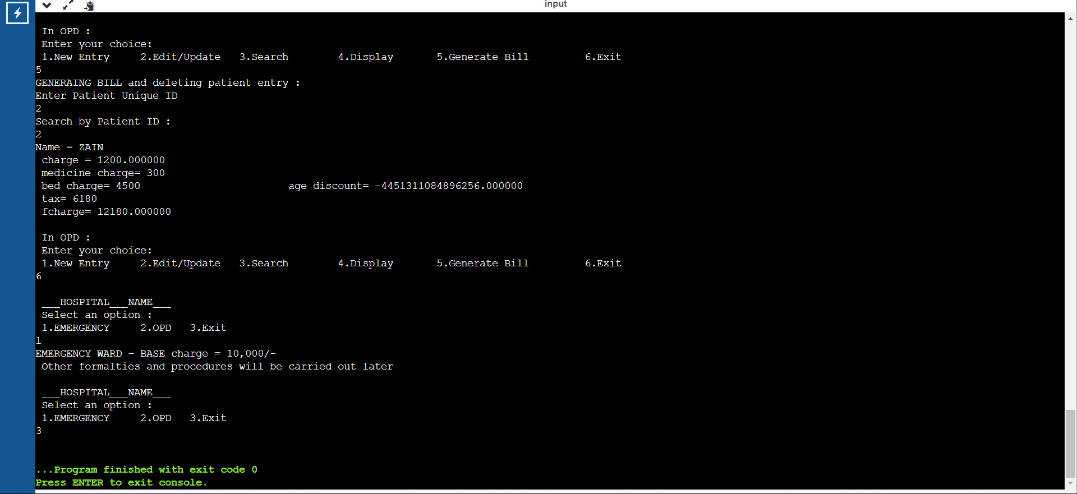
Outputs

Slide 12
Suggestions are most Welcome .
Do connect with us at :
https://t.me/+NwGf1B8wzpVhOGRl
Or
https://chat.whatsapp.com/DJRHZ8l1dFyEmAMQN67QTD

Slide 13
THANK YOU !!

